Slide 1
What is 80Hz anyway.

Slide 2
Questions:
Is this a continuous oscillation or is it CFC?
CFC for sure, but it may be more sporadic. Locked to 4Hz but who knows how regularly – seems pretty random.
Does it change by depth?
Is it locked in any way to motion? (don’t think so but need more tests)
Why do spikes phase lock to 80Hz power but not phase?
There is a decent relationship (negative) between 80 Hz freqeuency and 5 hz frequency. Why? No such relationships with power.
Suggests: 1: beta events may be at the lower end of 5 Hz, 2 They may be discrete.
Next Steps: Find a way of detecting gamma- based on power and number of cycles?? Then subject it to these analyses and re-confirm that these events occur with some relationship to 5Hz.
Q3_What_is_LDOPA_80Hz

Slide 3
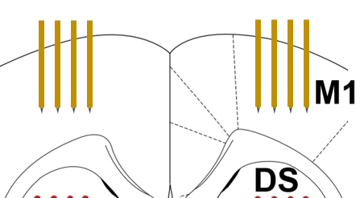
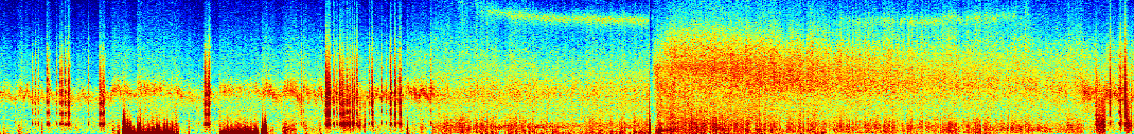

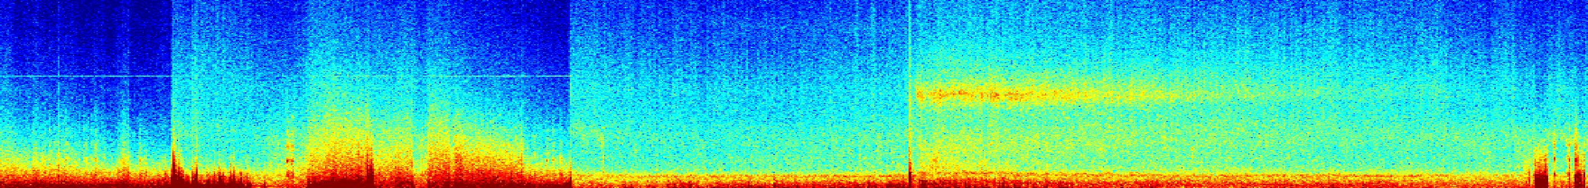
A
C
Movement
B
Bregma, AP 1.8mm
100
Lesioned Hemisphere (M1)
40
Lesioned (M1)
80
2
4
36
30
Hz
60
34
dB
1
3
dB
20
40
32
10
20
30
0
28
20
40
60
80
100
100
Unlesioned Hemisphere (M1)
40
Un-Lesioned (M1)
80
35
30
Hz
60
dB
dB
5
20
40
30
10
20
25
0
20
40
60
80
100
100
L-DOPA
150
Ketamine
200
250
Frequency (Hz)
C:\Users\Stephen Cowen\Box\Cowen Laboratory\Data\LID_Ketamine_Single_Unit_R56\Rat320\03
Plot was from LK_Find_best_LFP_for_a_band('gamma_80')
Notes:
A) Tetrode locations in M1. B) Beta oscillations observed in 6-OHDA lesioned hemisphere during circular treadmill walking. C) Movement (top) and spectral activity (bottom) in an LID animal (single session). Movement identified by tracking camera. Spectrograms for the lesioned (top) and unlesioned (bottom) hemispheres surrounding injection of L-DOPA and ketamine. Key: (1) clear beta prior to and shortly after L-DOPA (12 mg/kg). (2) 80-Hz γ activity 20-min after L-DOPA injection. (3) Ketamine (20 mg/kg) eliminates 80-Hz and triggers broad-band gamma. (4) 80-Hz re-emerges. (5) Unlesioned hemisphere shows focal 50-Hz γ.

Slide 4
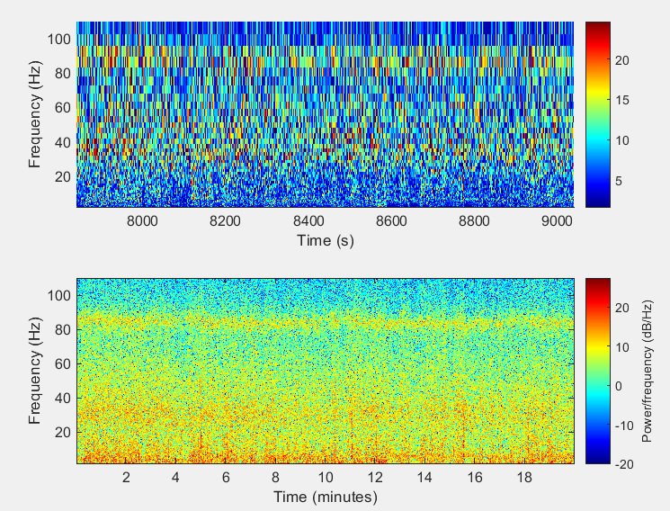
Data under analysis is the 30 – 50 minute period post L-DOPA injection. You seen nice 80 Hz.

Slide 5
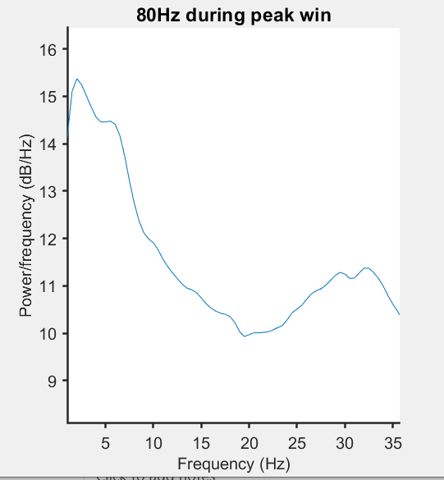
Verify that there is 80Hz in LDOP in this set
Rat320\03
Q3_What_is_LDOPA_80Hz
Black is from pre period.
Blue is the psd of the power envelope
Note 3-7 hz, Note 30 Hz.

Slide 6
Looking for correlations between power, 80hz, and low theta. Hard to see in these plots.

Slide 7
Power and spike variables
Bottom lines show yellow – mean firing rate
And the 2 principal components.
There was something of a correlation to the second pc.

Slide 8
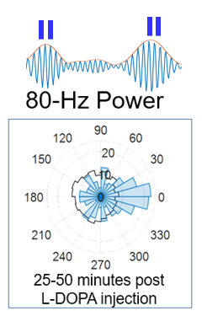
mnQ and sc are all from the spike train. The mnQ and Sc2 had a small significant correlation with 80Hz power. This is consistent with the phase locking of individual cells that I observed. Plot below is a single neuron phase locking to 80 Hz power.

Slide 9
Looking at wavelet spectrogram – you see that it’s not 80 Hz all the time. A lot of variation. A lot of mixed things happening in beta range as well.

Slide 10
Here is a more blown up representation. Interesting how the regular spectrogram (bottom) shows off the 80 Hz more nicely than the wavelet (top). This might be because the 80 Hz is more punctate, apparently correlating with slower 5 Hz oscillation events.

Slide 11
Powerpower correlation(left) shows some patterning but nothing as I predicted as nothing is really correlated with 80 Hz. Nothing with phase.

Slide 12
CFC
This was cool – clear coupling between low theta and 80Hz. Finally some relationship.

Slide 13
The CFC frequencies dance around
Each is from a 2-3 min interval.
The best CFC seems to move dynamically. Wonder if there is a relationship here.

Slide 14
Do changes in instantaneous frequency predict state? Maybe
Initially I thought so but then realized I was looking at all of the data and not just the 80 Hz state.

Slide 15
instfreq
There is a very strong NEGATIVE relationship between the frequency (not power) of 80 Hz and low theta.

Slide 16
Relationship to power
I did this for power but the relationship is MUCH weaker.
I tried using other estimates of power – from the wavelet and spectrogram function. As with this, very very small or non-existent relationship

